Slide 1
Wina Culture trip 2026
What, Who, When, Where?

Slide 2
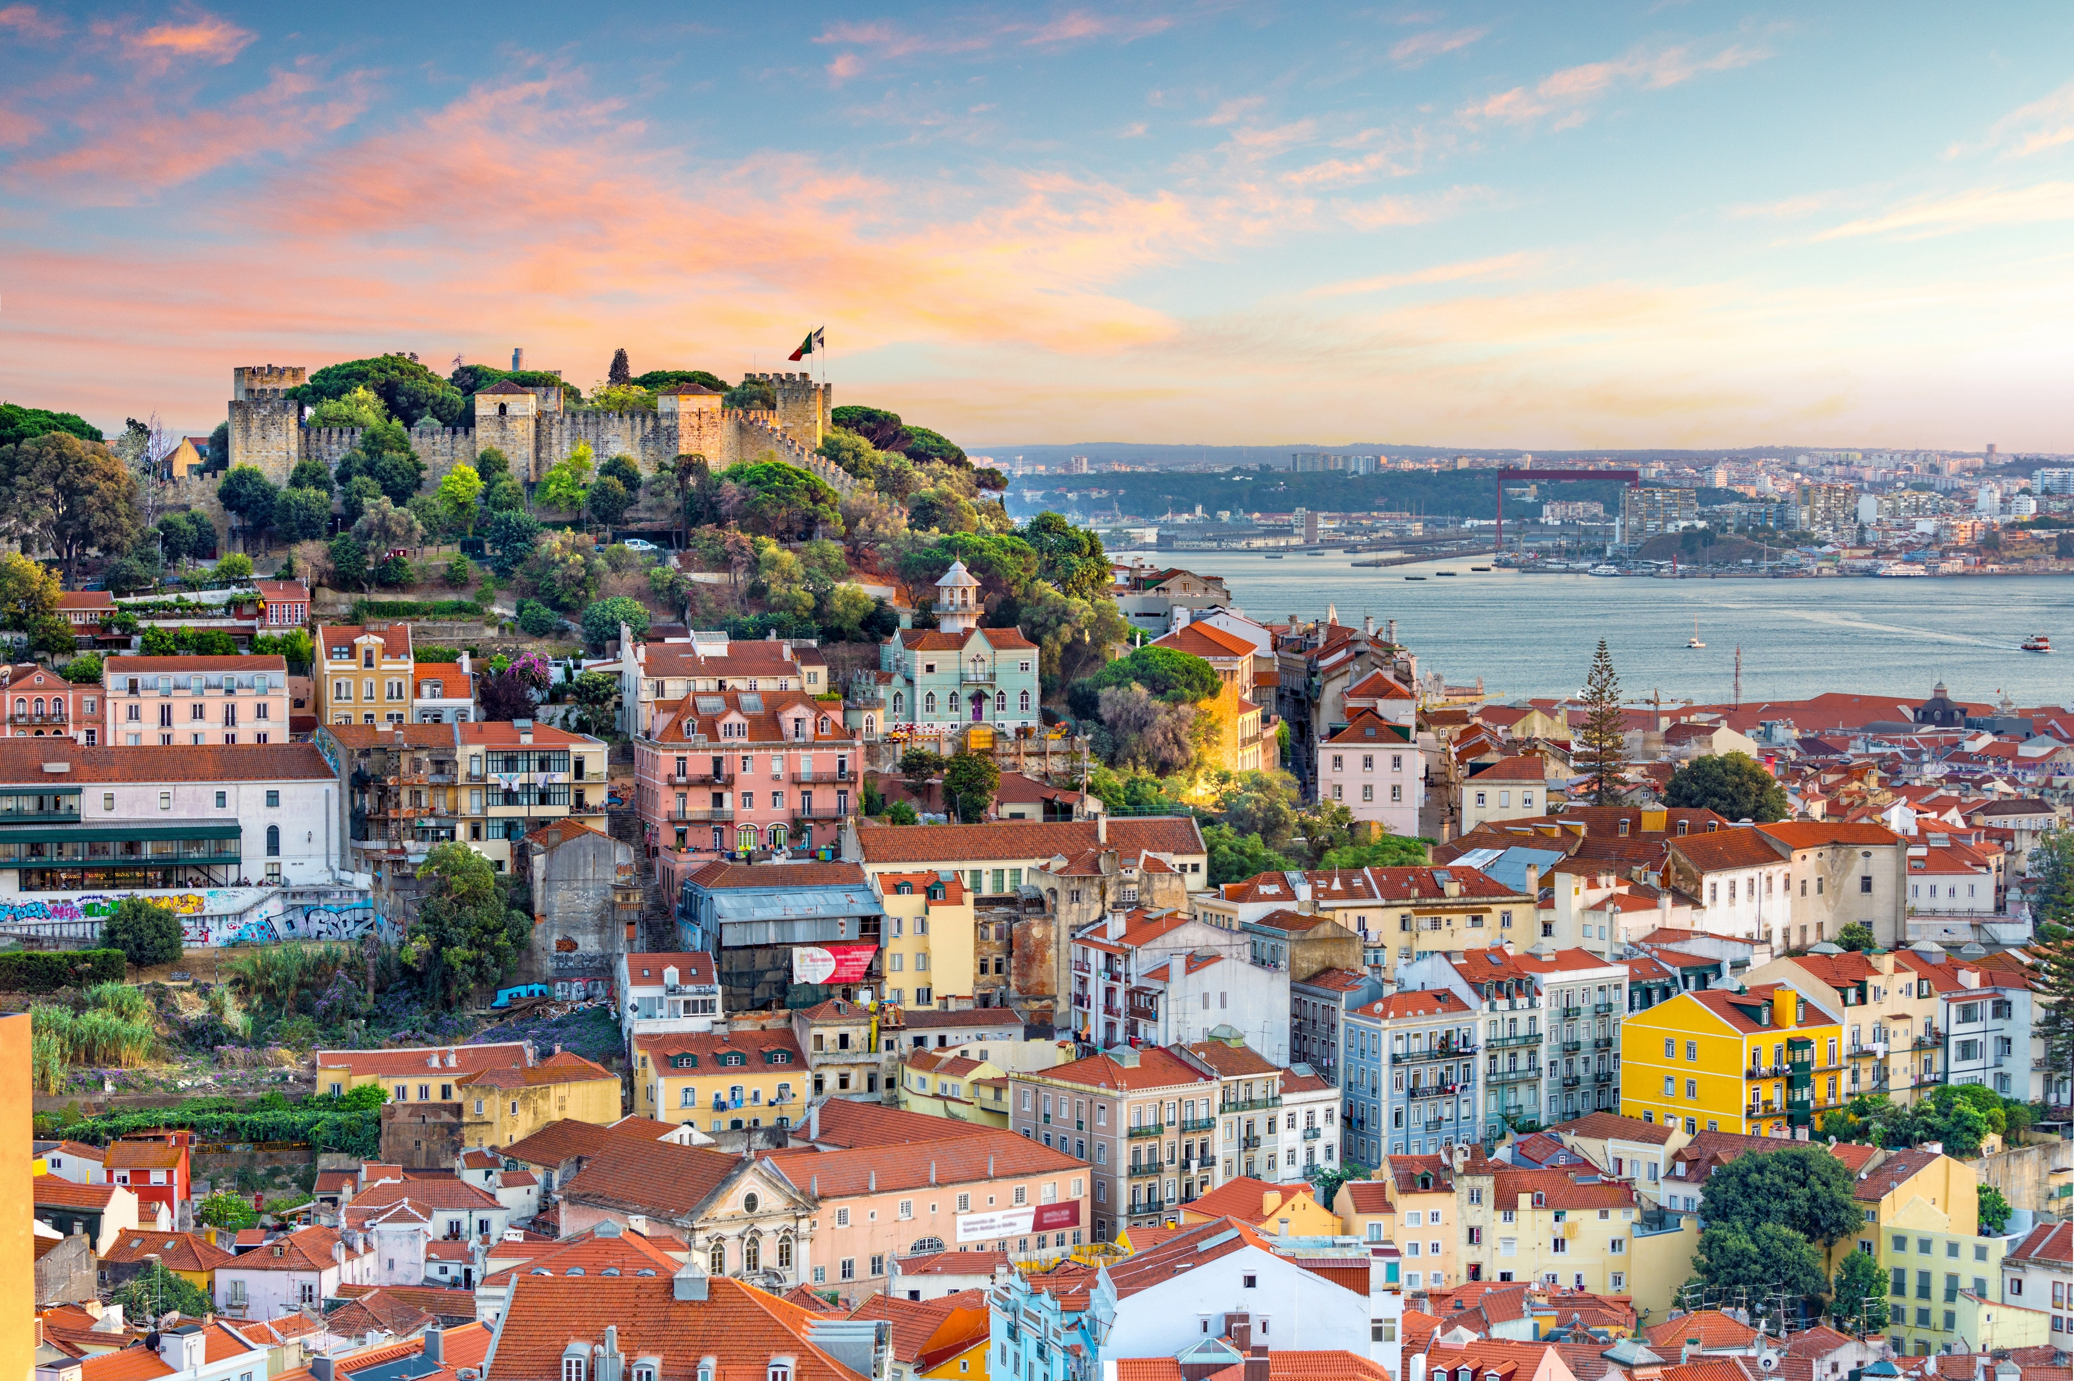
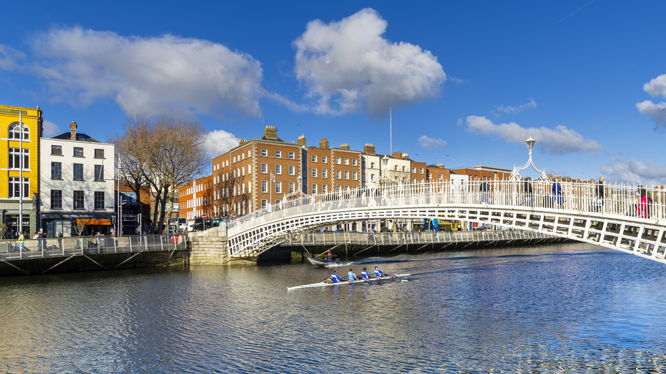

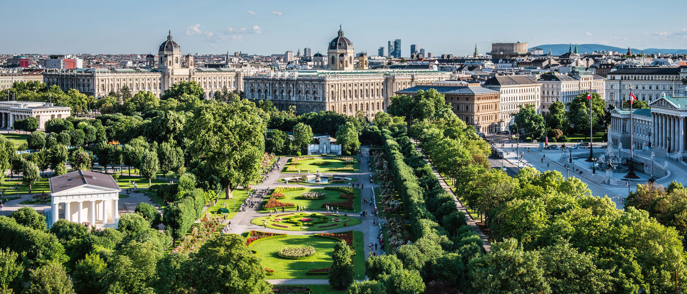
Wat is cultuurreis?
Yearly
City
Culture
Walking
Concert

Slide 3
Practical
Sat 31/1 tot Fri 6/2 (Class free week)
€350-370, first payment of €220
Next week on Monday: registration opens at 1PM

Slide 4
We go to…

Slide 5
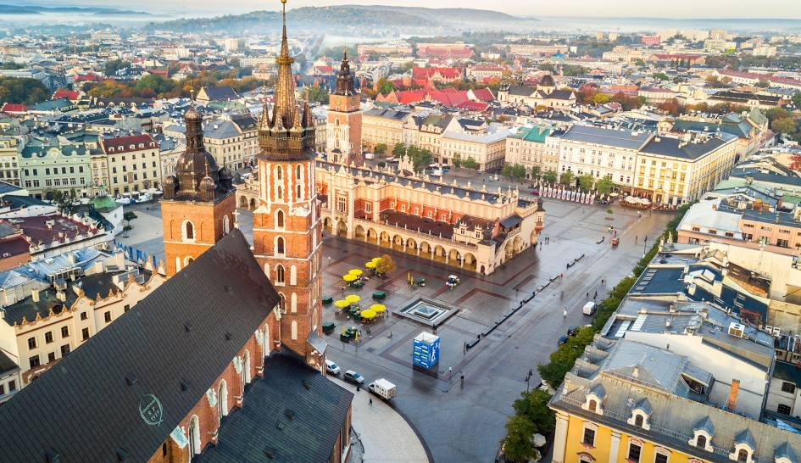
KRAKÓW

Slide 6
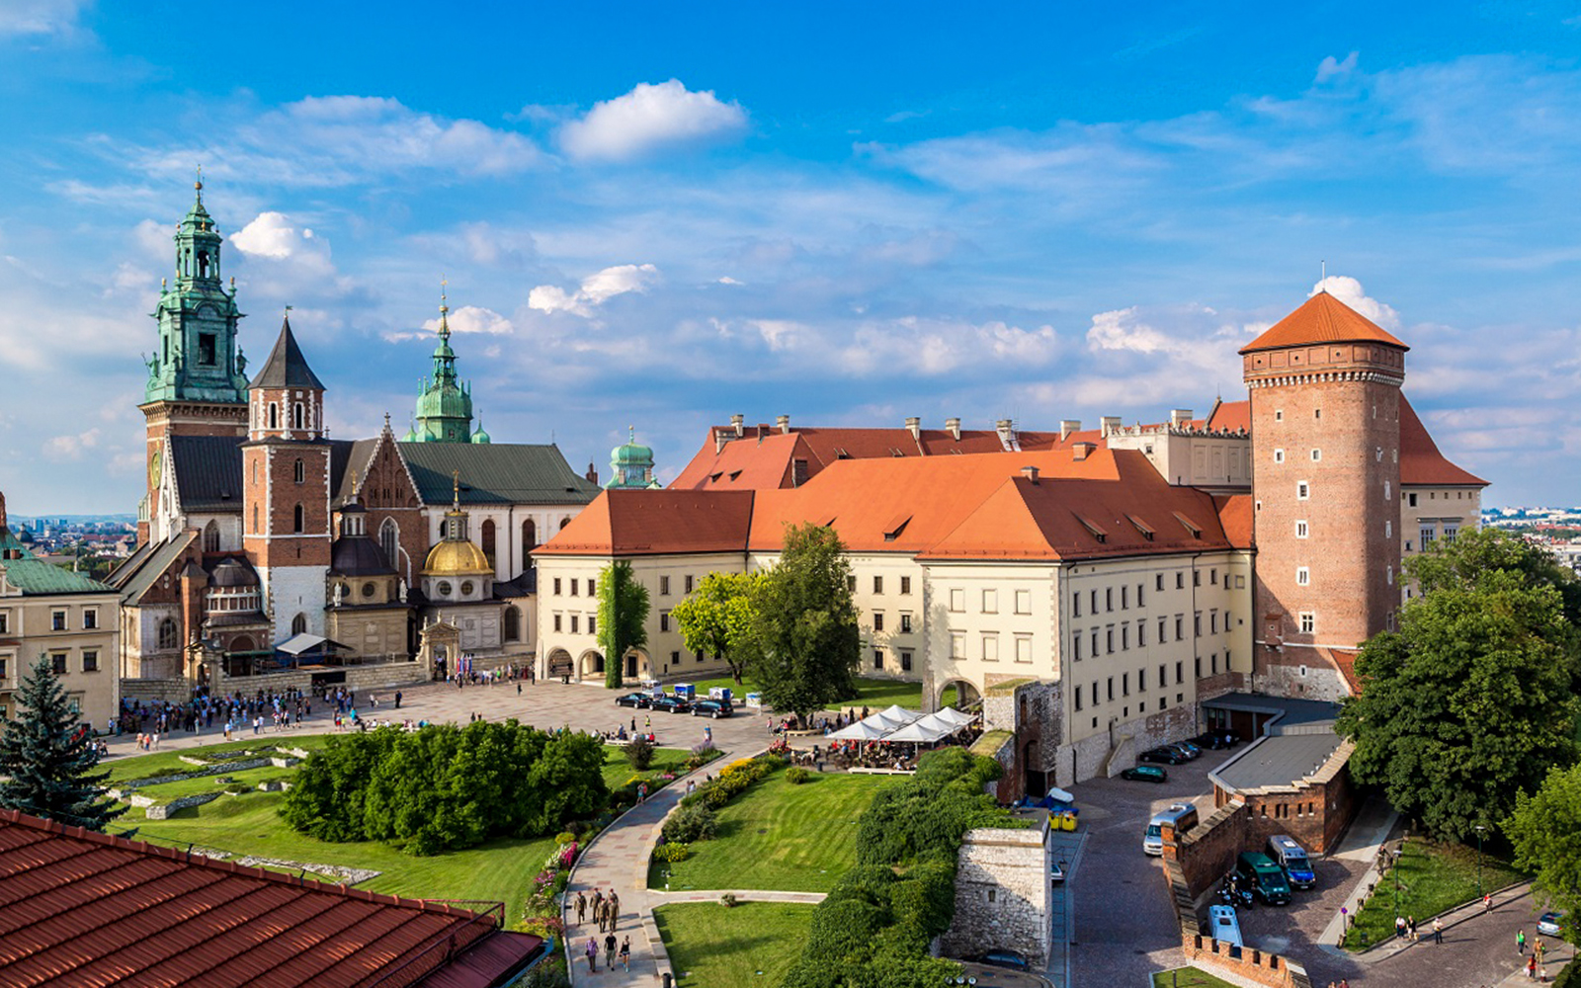

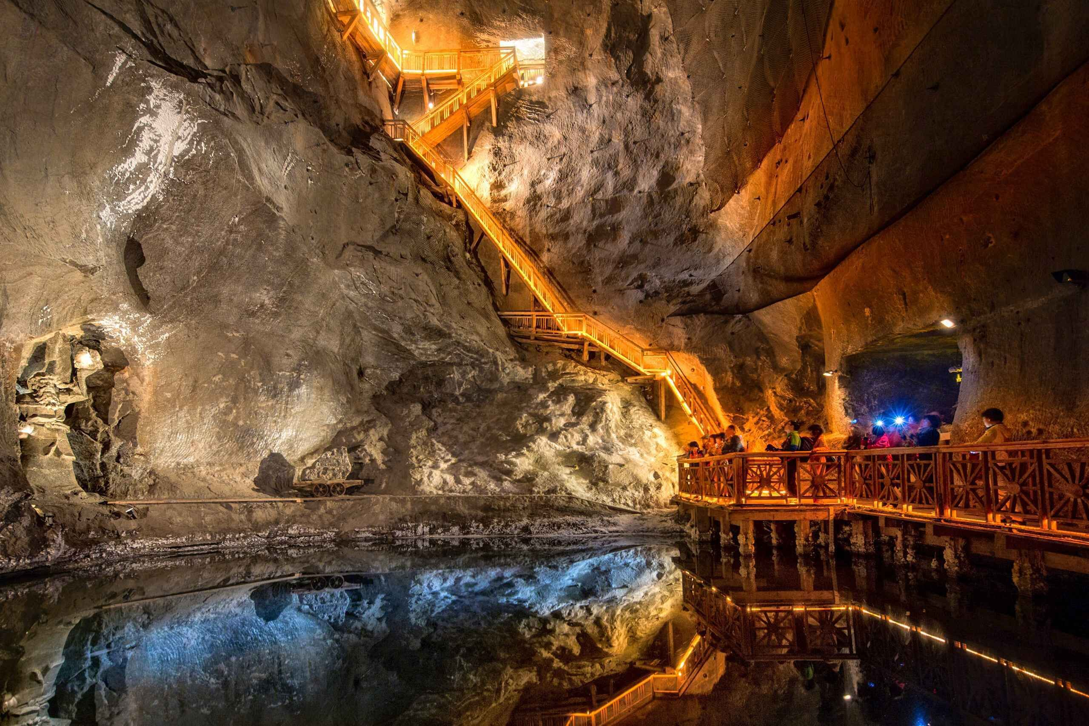
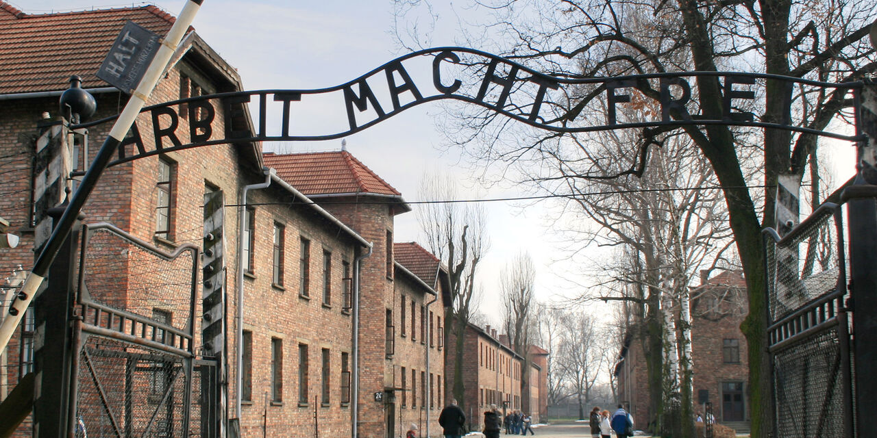
What are we gonna do?
Wawel Castle
Concert (optional)
Walk
Wieliczka salt mines
Auschwitz (optioneel)

Slide 7
Culture pass
Last 3 days
38 museums/monuments for free
TAKE YOUR STUDENT ID WITH YOU!!!
Vrijheid
Included in the price

Slide 8
How do we get there?
Plane (CRL, Meet in Leuven)
Back (EIN, End in Antwerpen)

Slide 9
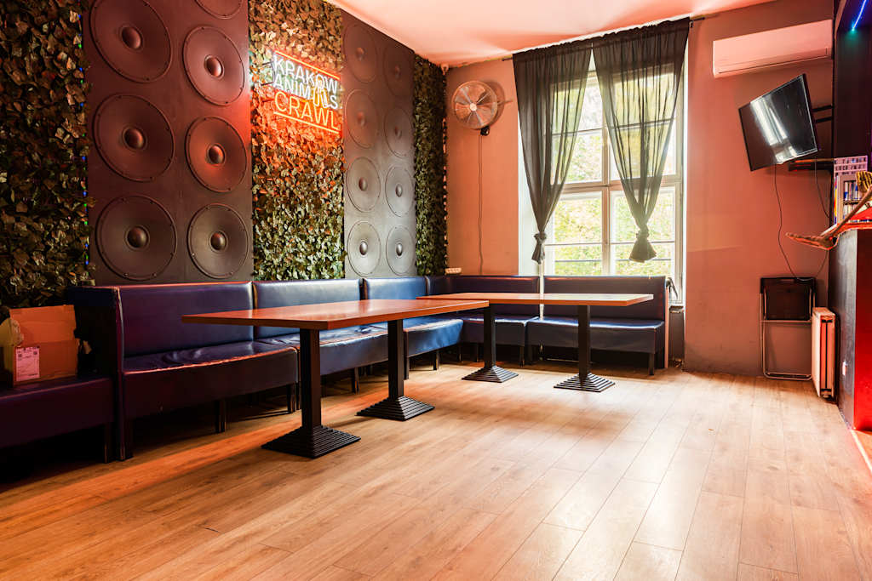
Waar slapen we?
Party rock hostel
Happy hour
Party hostel

Slide 10
Summary
Kraków
Activities
Culture Pass
Party rock hostel

Slide 11

Any questions?

